Slide 1

RIGHTS OF SPECIAL PERSONS WELFARE FONDATION
(ROSP)
ANNUAL REPORT
2022-2023
Address: 12/A Canal Bank Extension Mughalpura Lahore.
Email: rosp2716@gmail.com
FB Page: @786ROSP Insta: ROSP786
Website: www.rosp.org.pk Email: Info@rosp.org.pk
042-3686661-2
0322-6666530 / 0333-3339210

Slide 2

















Our Partner Organization

Slide 3
TABLE OF CONTENTS
Vision and Mission
Board of Trustee
Message from CEO
Programs & Project
Activities at the Glance
Objective
Our Services
MEDIA COVERAGE
Accounts Detail
MOU with different Institute
Sponsership Forms

Slide 4
ROSP INTRODUCTION
Rights of Special Persons (ROSP) Welfare Foundation was founded in 2016 to address the issue in a more sustainable way, by providing quality education, accommodation, nutritious food, vocational training, placement based rehabilitation and achieve personal independence. ROSP Welfare Foundation works towards creating an inclusive society which provides equal opportunities – without any discrimination – for th e development of persons with disabilities.We are working on all disability before 5 year and by the Grace of Allah our organization Registered With the Social Welfare Department under the Voluntary Social Welfare Agencies (Registration & Control) Ordinance 1961, Pakistan Centre for Philanthropy (PCP) is a non-profit organization registered on 27th December, 2001 with Securities and Exchange Commission of Pakistan (SECP) and licensed under section 42 of the Companies Ordinance 1984, The Punjab Charity Commission Act 2018, Punjab Welfare Trust For The Disabled, FBR, & also Our Organization Tax Exempted Under Section 2(36) Of Income Ordinance 2001.
MISSION STATEMENT
Rights of Special Persons (ROSP) welfare Foundation mission is to provide a platform for persons with disabilities to develop to confidence to lead independent, sustainable social and professional lives trough awearness campaigns, education, health and nutrition, skill development, disability rights advocacy, social integration, and employement generation.
OUR VISION
An inclusive society, free from discrimination , where persons with disabilities (PWDs), become contributing members, living with respect and dignity.

Slide 5
Board of Trustees
Mr Wajid Hussain President
Ms Najma BB Senior Vice President
Ms Zubaida Naz Vice President
Ms Ayesha Shahzad General Secretary
Ms Sana Amber Finance Secretary
Mr Israr Hussain Joint Secretary
Ms Maryum Latif InformationSecretary

Slide 6
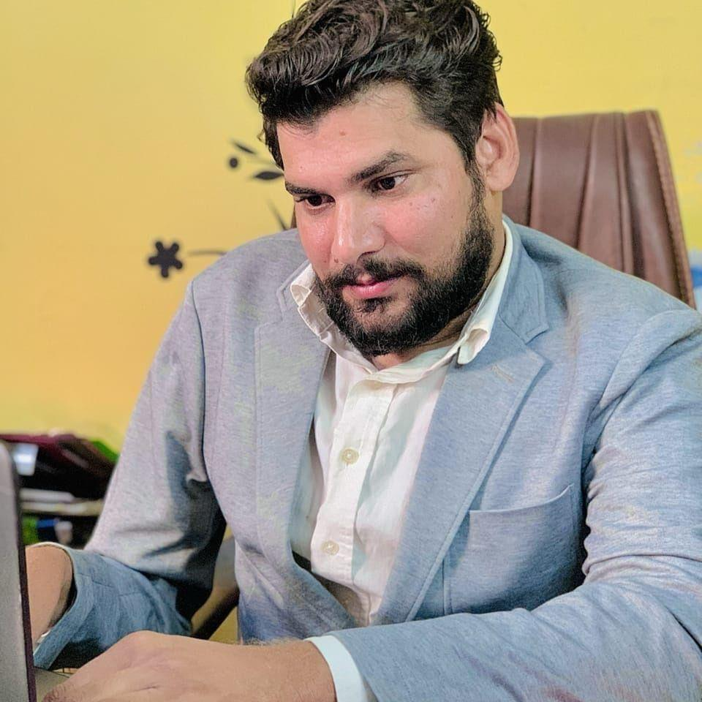
MESSAGE FROM THE PRESIDENT
Assalam-o-Alaikum!
I avail this opportunity to express my profound graitude for the Sponsors, Trustees, Members and Friends who have shared and supported with unequivocal commitment the events and endeavors of the Foundation to accomplish its objectives. It is a matter of record that the untiring teamwork of the members of the staff and their dedication to pursue enthusiastically the cause has played a vital role in the steady growth of the Foundation. Accordingly, all of them deserve exclusively my personal appriciation in recongnition of their fruitful and rewarding contribution.
Let us together and help people live their best lives! We wish to improve the lives of people with disabilities. We want to make a difference, I believe that we can make the life of people with disabilities easier and prosperous just by focusing on their hidden talents and by raising their morale and confidence. The only thing is that they only need aplatform from which they can raise their voice and deliver their message to the rest of the world. In order to sort out this issue, I have decided to develop an organization which will help the people with disabilities in each and every aspect of life and that will become the voice of disabled persons.
Everyone lives for himself; it is a very common thing. We decided to make a difference and “LIVE FOR OTHERS” . We believe that education is the most crucial foundation stone of any society; without education the development and progress of any nation is not avhievable. We are aimed to fight for the rights of the disabled persons and try to put our maximum whatever we can do for their welfare. We shall work at national and International levels to achieve the objectives of the United Nation Convention on Rights of Persons with Disabilities. We shall assist PWDs in bringing their hidden potential to Surface by providing career guidance. The only thing we need is your continous support and prayers to achieve such a great goal. May ALLAH SWT help us to achieve such sacred goals to the best of our best.

Slide 7
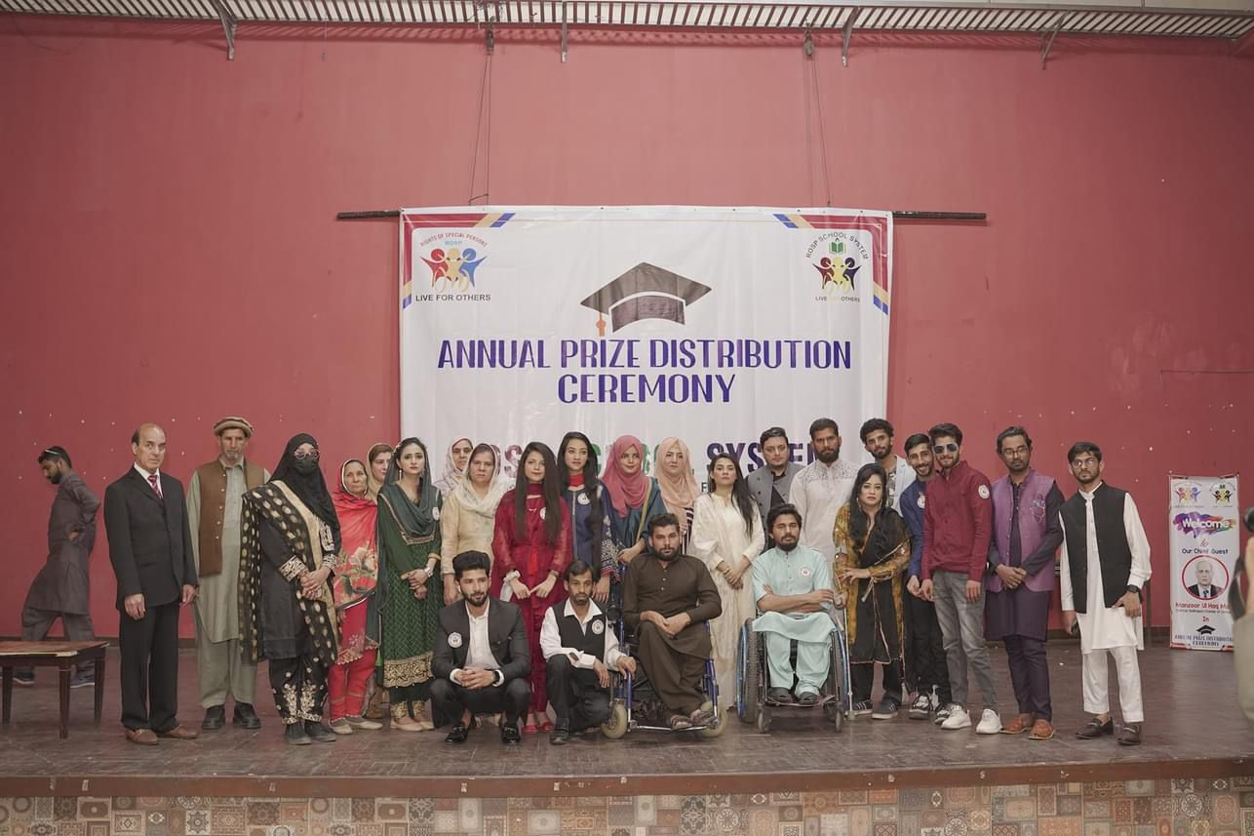
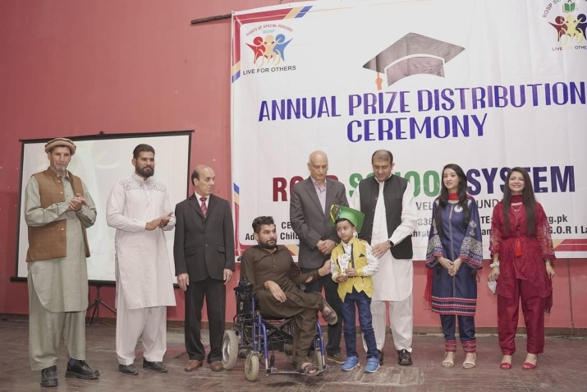
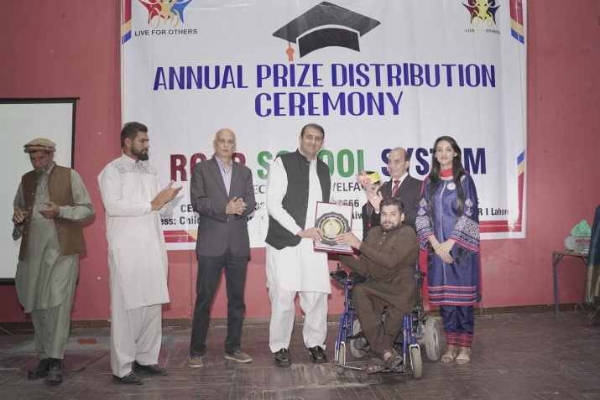
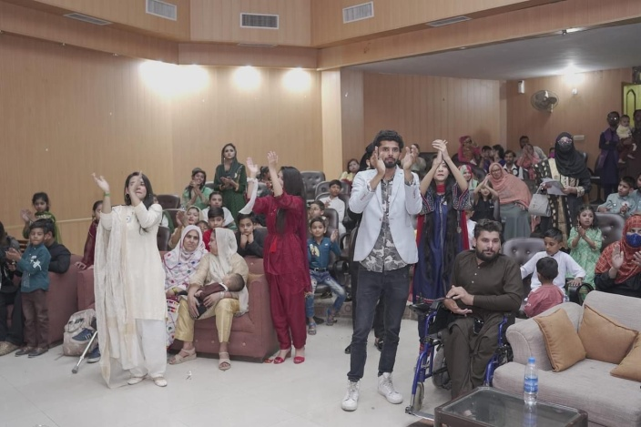
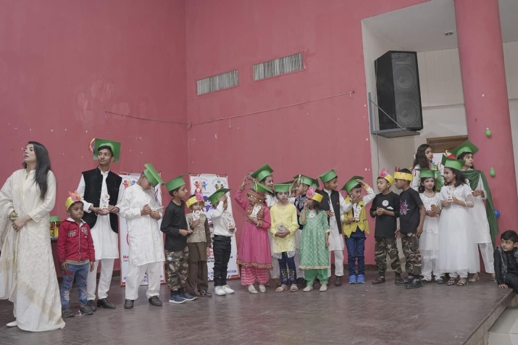
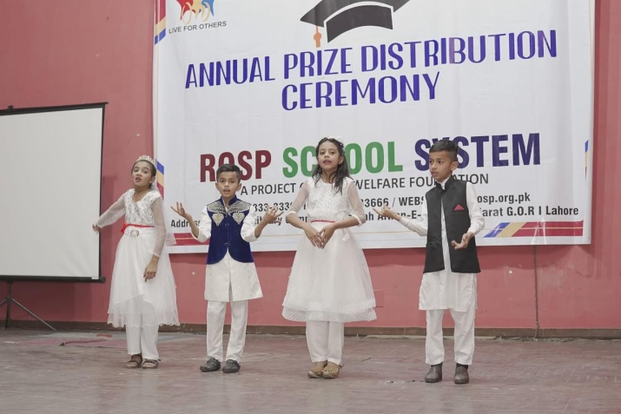
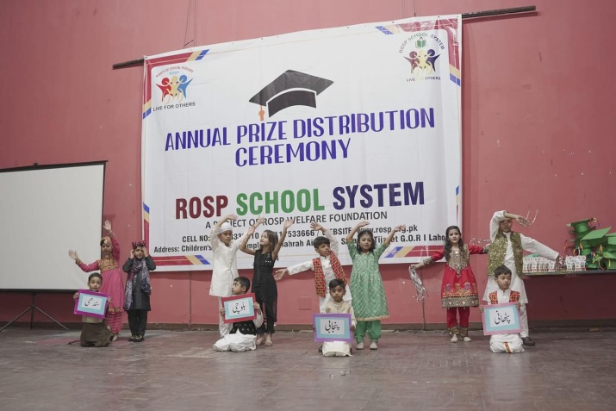
ROSP SCHOOL SYSTEM ANNUAL PRIZE DUSTRIBUTION CEREMONY
Held On March 5th, 2023At Children's Library Complex Lahore"This Programme Started With The Recitation of the Holy Quran by ROSP School Child’ Then Naat-e-Rasool Maqbool Was Presented.ROSP School childrenPresented Very popular National Songs And Cultural, Balochi K. P. K Punjabiand SindhiTablus, Which Were Appreciated By All In The Audiance, Programme Was attended by chief Guests, Janab Manzoor Ul Haq Malik ( Chairman Of Sheikhupura Chamber Of Commerce ) And Janab Mian Muhammad Akram Usman ( MPA PTI )Who alsopresented sheild,to school children,Teachers And Children Who Presented Items At The Stage.President Of ROSP School And Foundation ( Mr Wajid Hussain ) Presented Shields To Chief Guests And Thanked To All Who Came To This Programme.

Slide 8
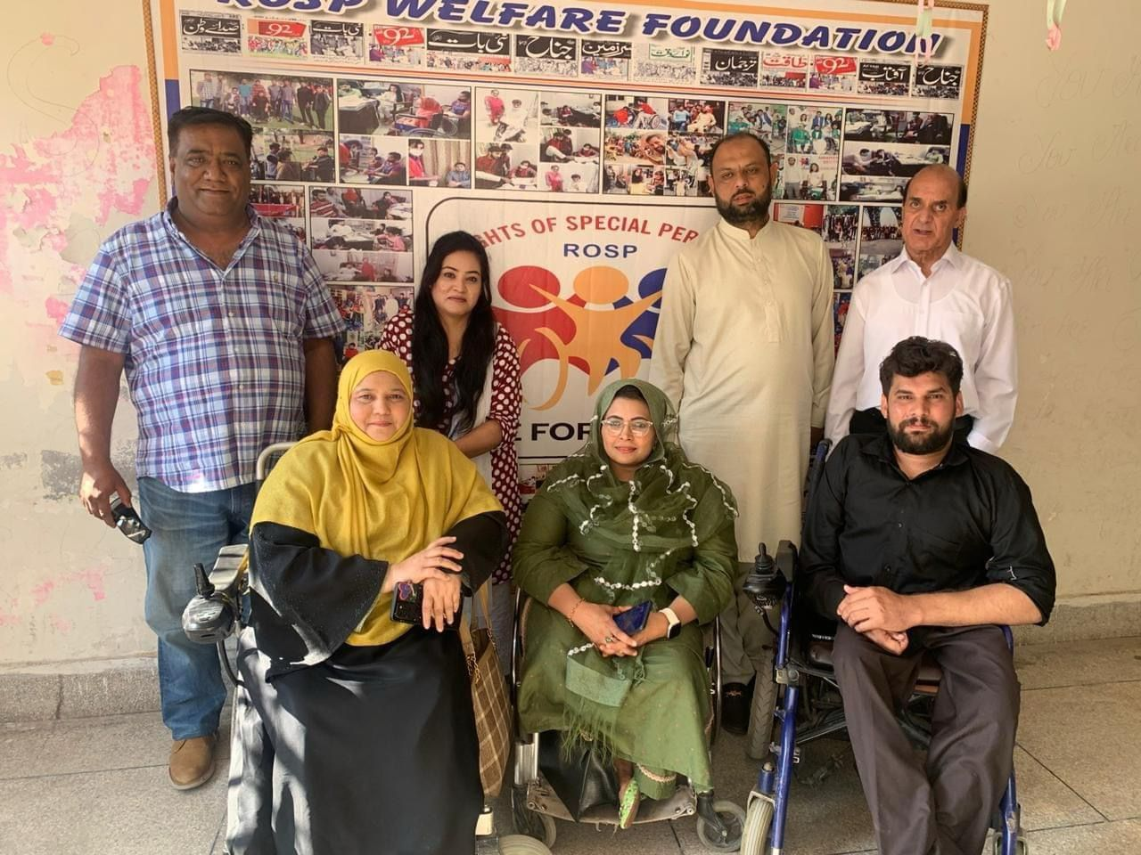
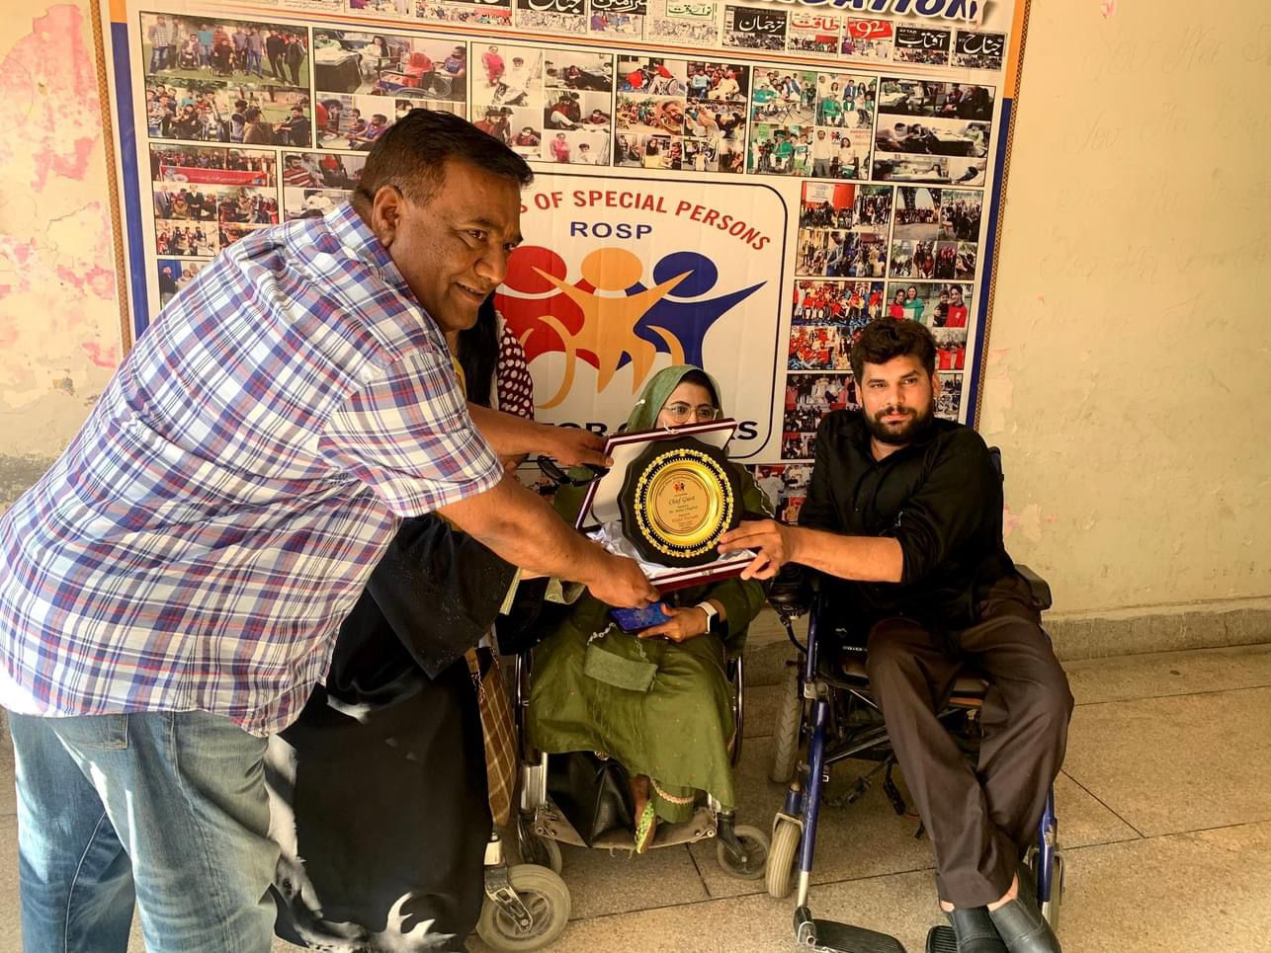
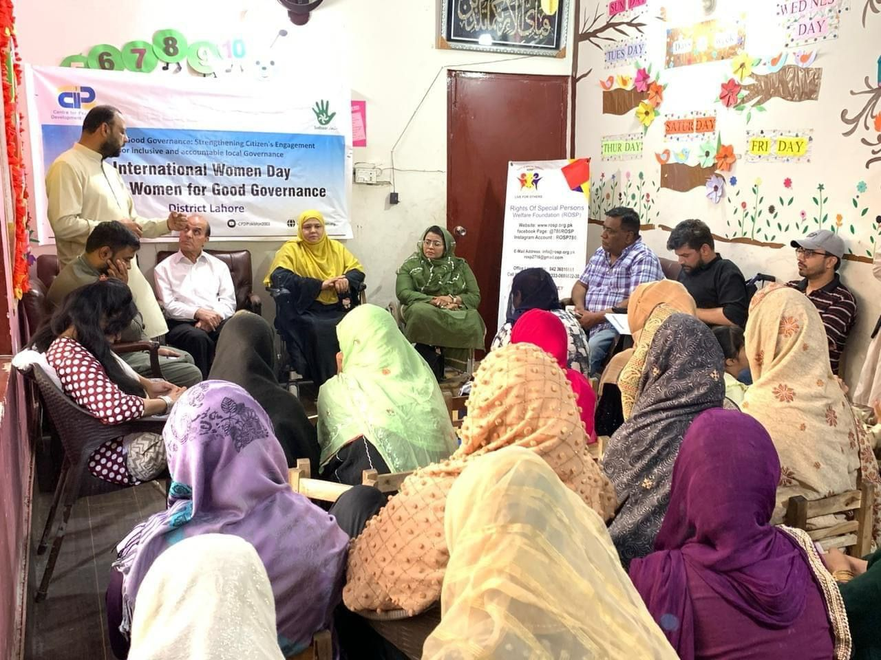
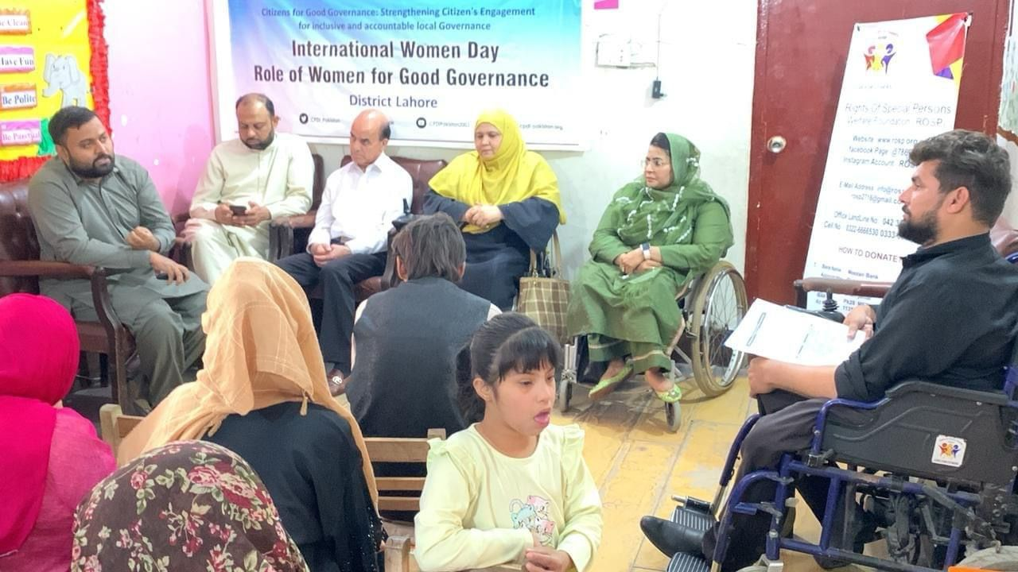
International Women's Day
International Women's Day Celebration was jointly organized by CIP ROSP Welfare Foundation and Sudhaar Society The programme started with the Recitaion from the Holy Quran by MS Ayesha (ROSP) Naat Rendition was done by Mr Abdul Rasheed (ROSP) Wajid Hussain President ROSP Abdur Razzaq (ED) ROSP MS Imtiaz Fatima Voice Society (GS) MS Shagufta Khanum (VP) Voice Society MS.Raffat Syed Habeel ROSP and Mr.Mohsin Riaz Sudhaar Society .. President Wajid Hussain presented ROSP Souvenir Shield to Mr Babar Chughtai.International Women's Day (IWD) is a global holiday celebrated annually on March 8 as a focal point in the women's rights movement, bringing attention to issues such as gender equality, and violence and abuse against women.

Slide 9
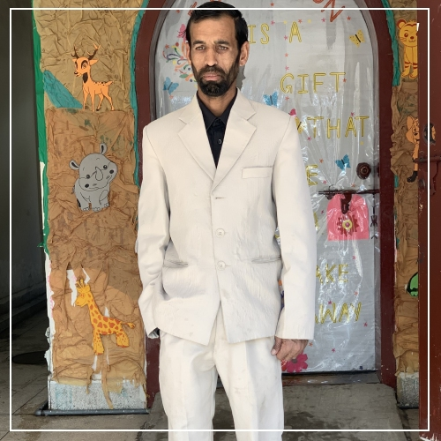
SUCCESS STORY
( Abdul Rasheed )
Abdul Rasheed suffered from blindness- in 2016, he joined ROSP Foundation as a member. He had 3 wishes: (1) wanted to have a house with washroom (2) water well and then get married with full support from ROSP Foundation, he has achieved all of the above wishes and leading a very happy married life now he is working fulltime with ROSP Foundation

Slide 10
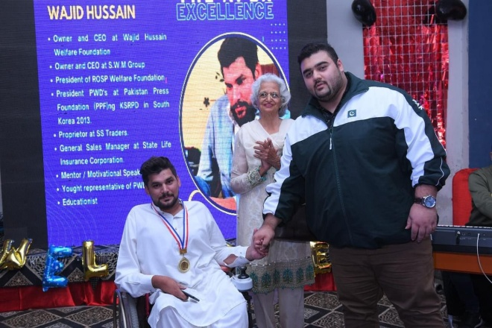
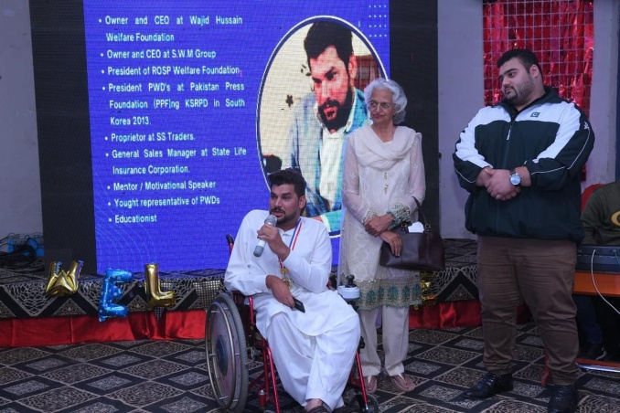
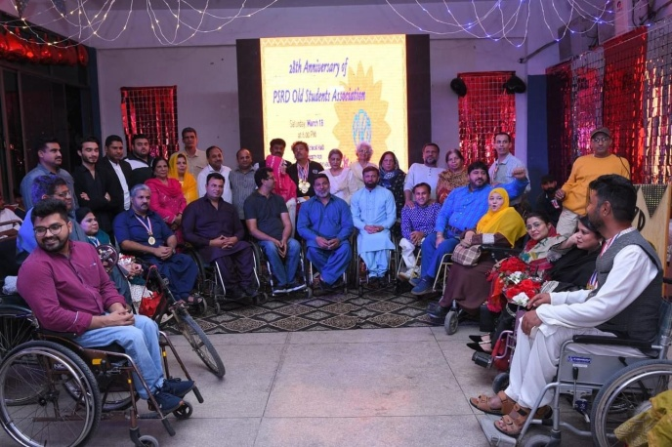
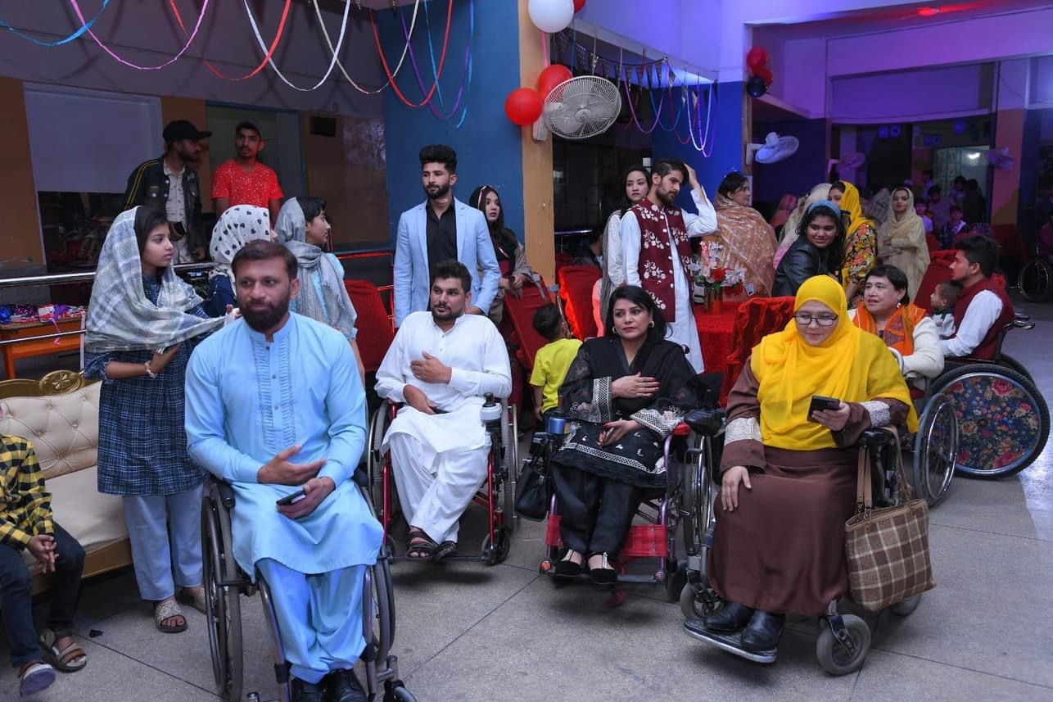
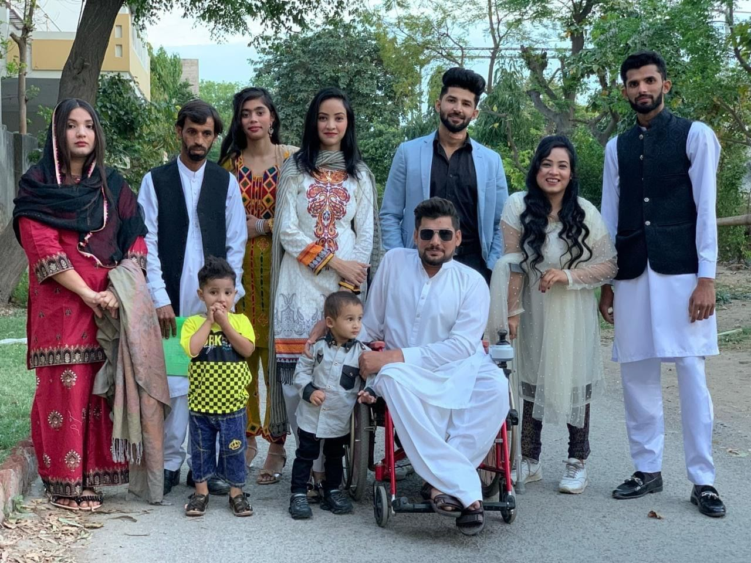
EXCELLENCE AWARD
28th Anniversary of PSRD Old Student Association Wajid Hussain President Rights Of Special Persons Welfare Foundation Received Excellence Award.

Slide 11
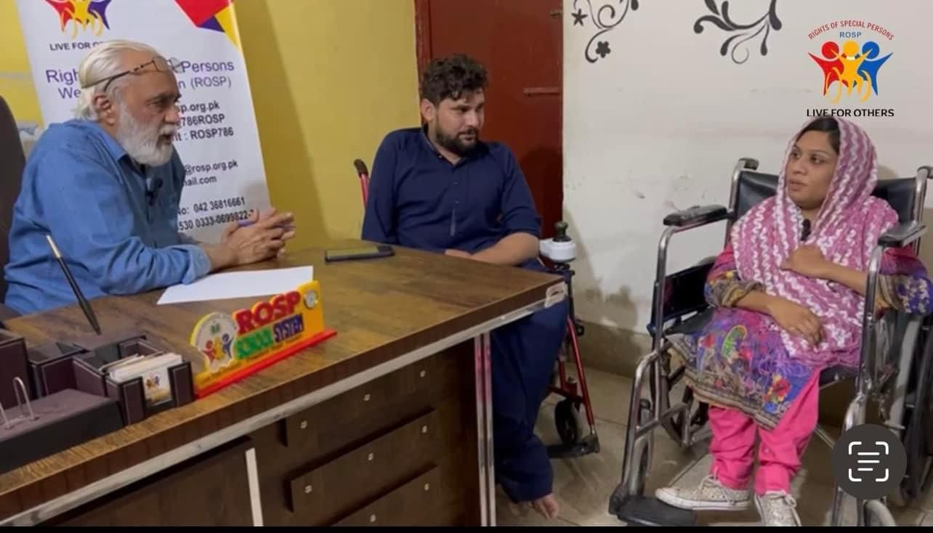
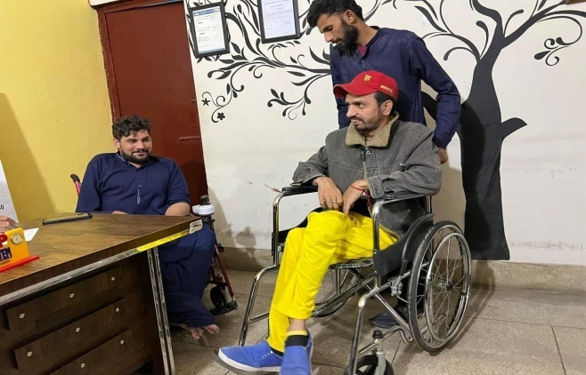
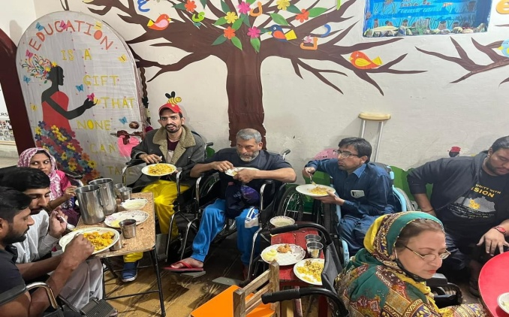
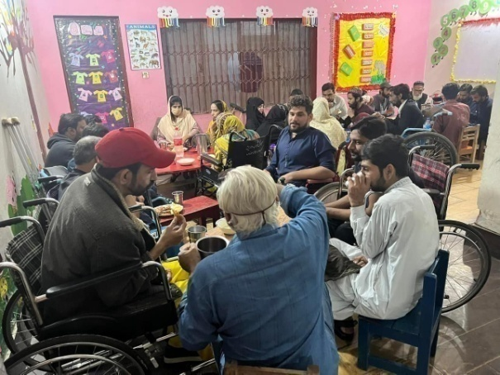
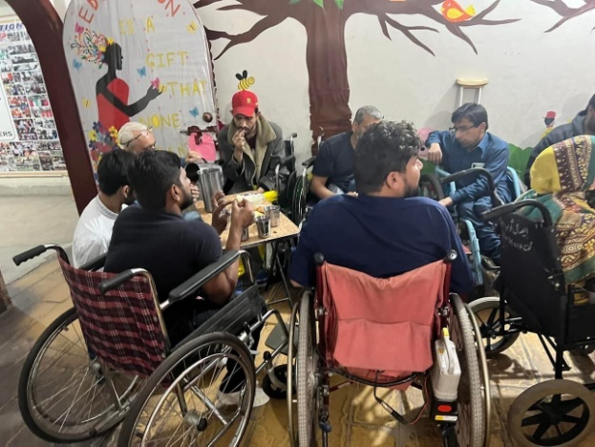
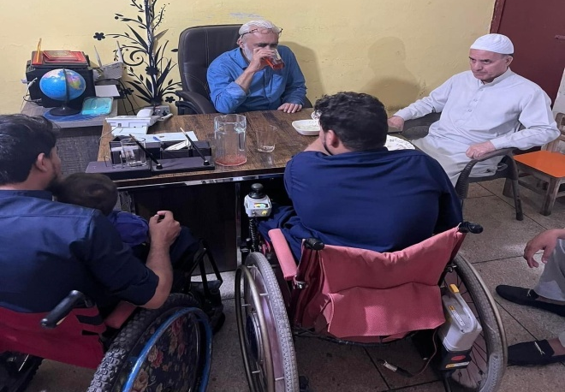
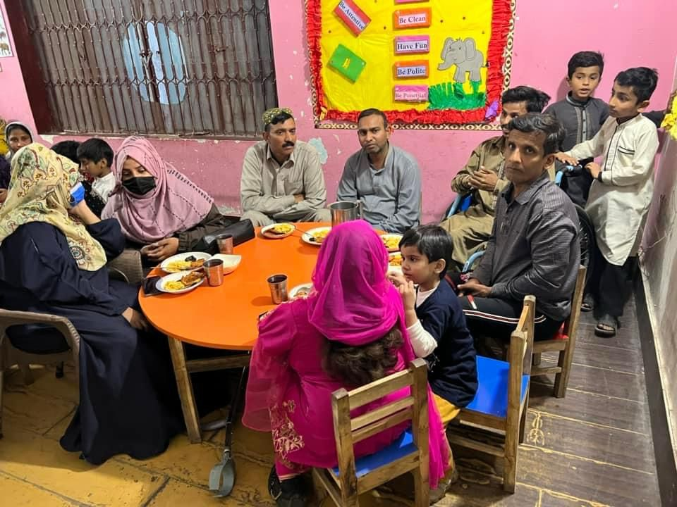
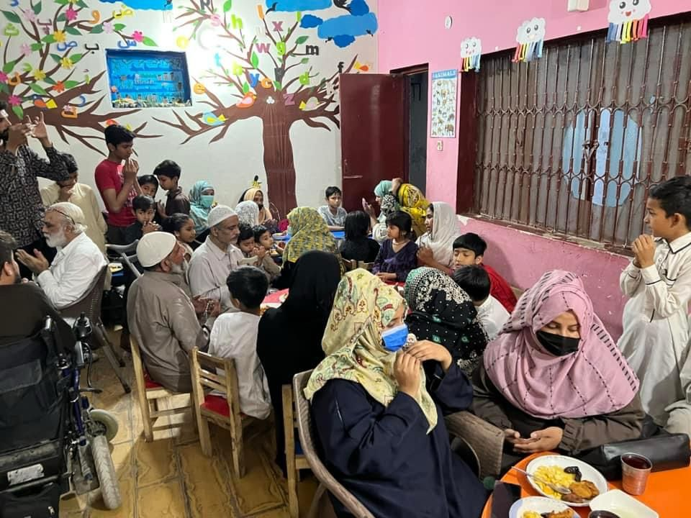
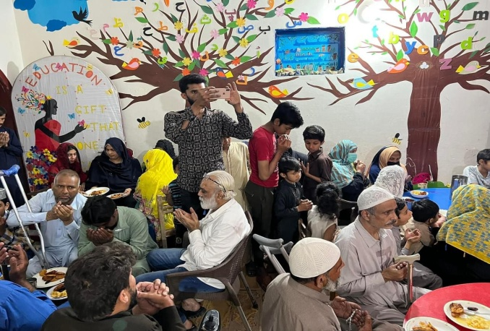
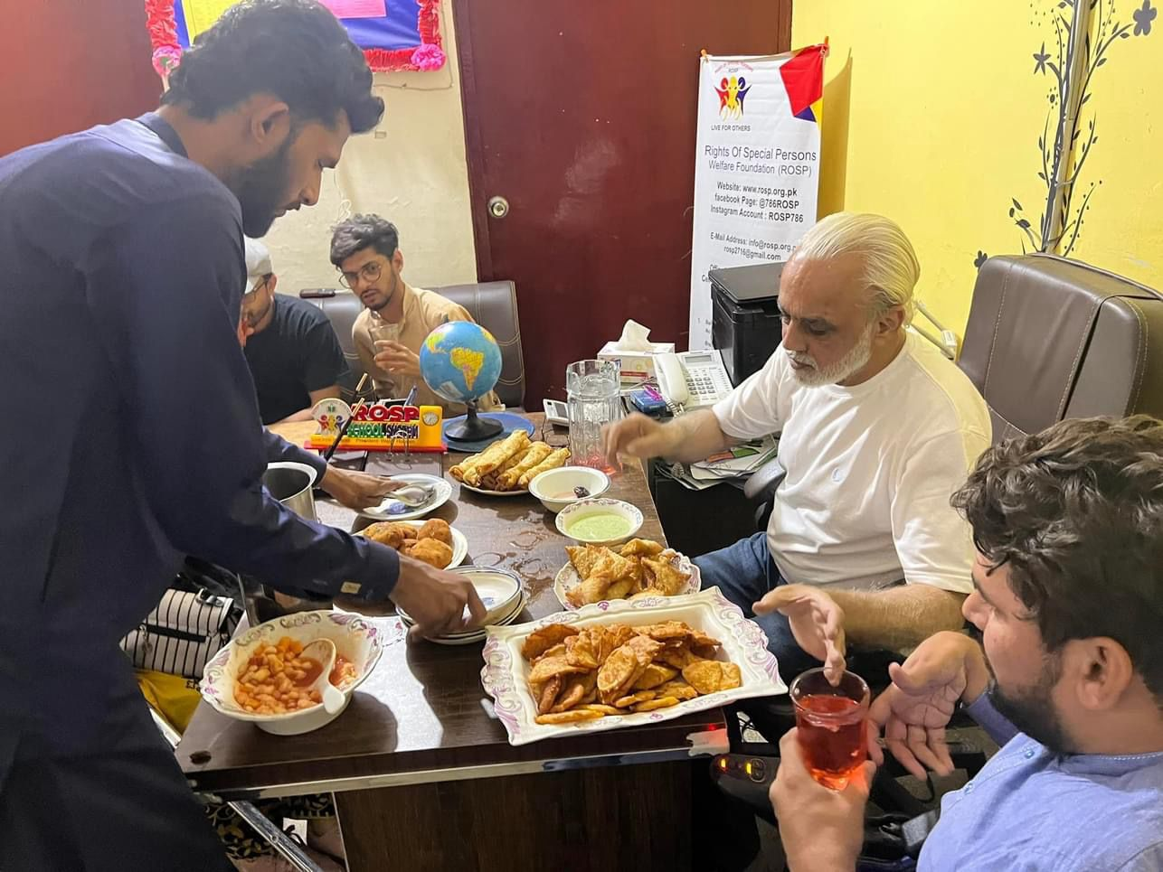
Iftar & Dinner and Discussion issues about PWDs
Alhamdulillah 8th Ramadan Distribution by ROSP Welfare FoundationThis year also we will fulfill thousands of people's happiness and their little wishes which are as follows. Wheelchairs Special bikes RationAnd Eid gifts We need your cooperation in this noble cause. Come and celebrate Ramadan Mubarak .

Slide 12
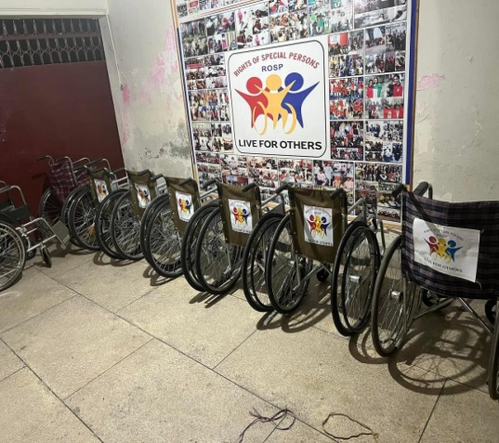
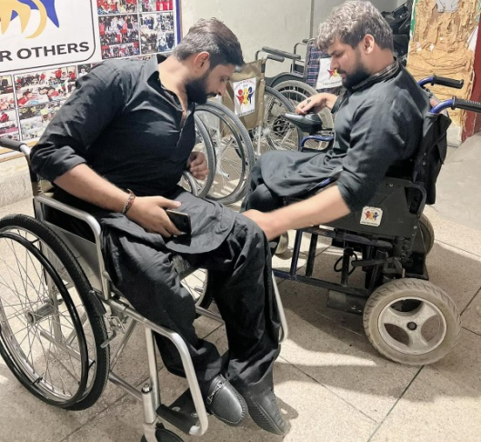
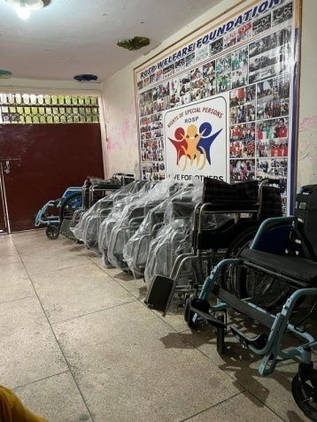
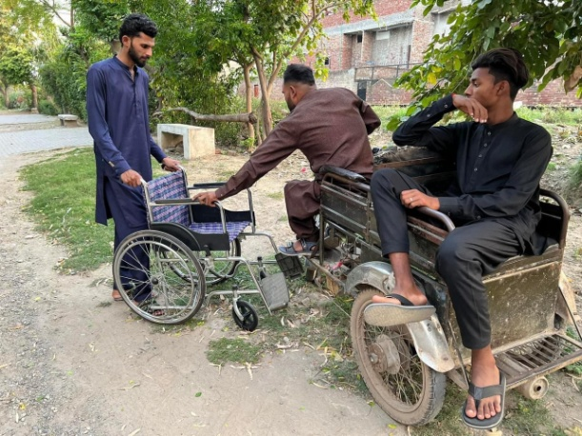
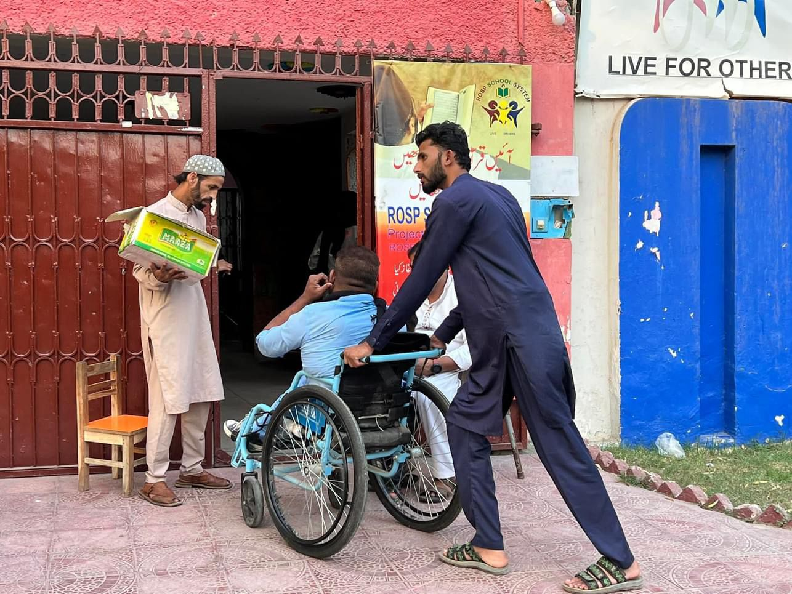
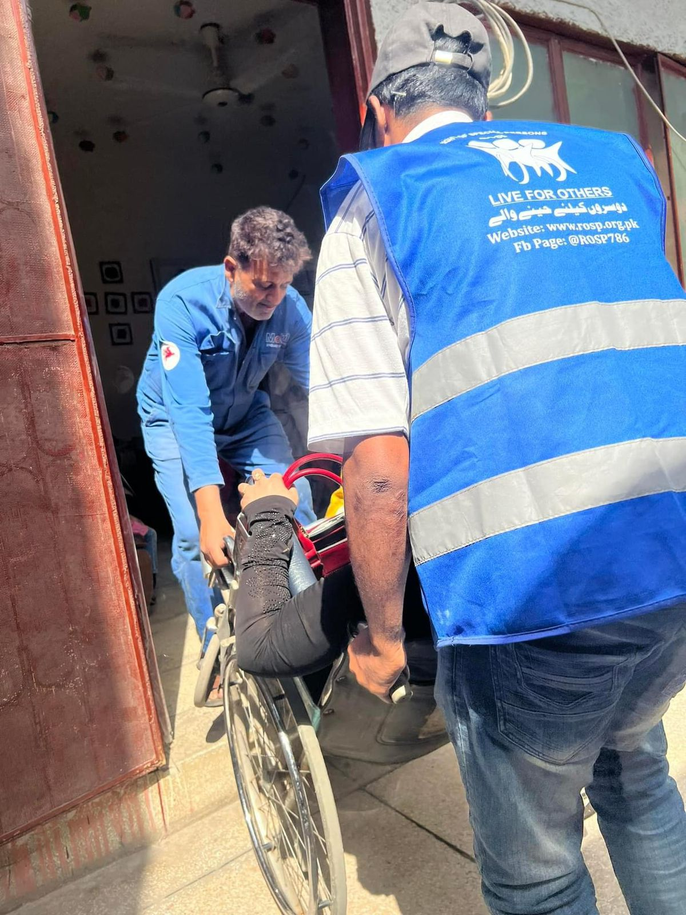
ROSP Mobility
Wheelchairs are perhaps the single most crucial thing for a person with any disability. Understanding the significance and sensitivity of wheelchair in a disabled person’s life, ROSP designs special wheelchairs for every disability. The specificity of the wheelchairs helps a disabled person to carry all the daily life activities independently without relying on anyone else.
ROSP has a tradition of arranging and distributing wheelchairs. This wheelchair distribution is carried out on annually during the holy month of Ramadan. Over the 3 years, the organisation has able to arrange and distribute around 250 wheelchairs. The distribution ceremony also provides ration to more than 200 disabled people. Along with that, the organisation has successfully distributed 2 specially assembled bikes and one Auto Rickshaw for people with disabilities. These new beneficiaries are then further engaged in ROSP’s self-sufficient program.

Slide 13
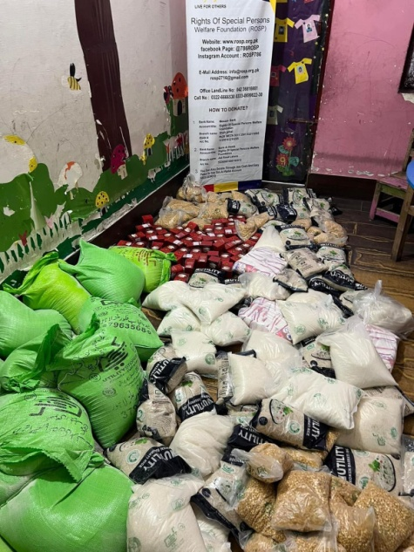
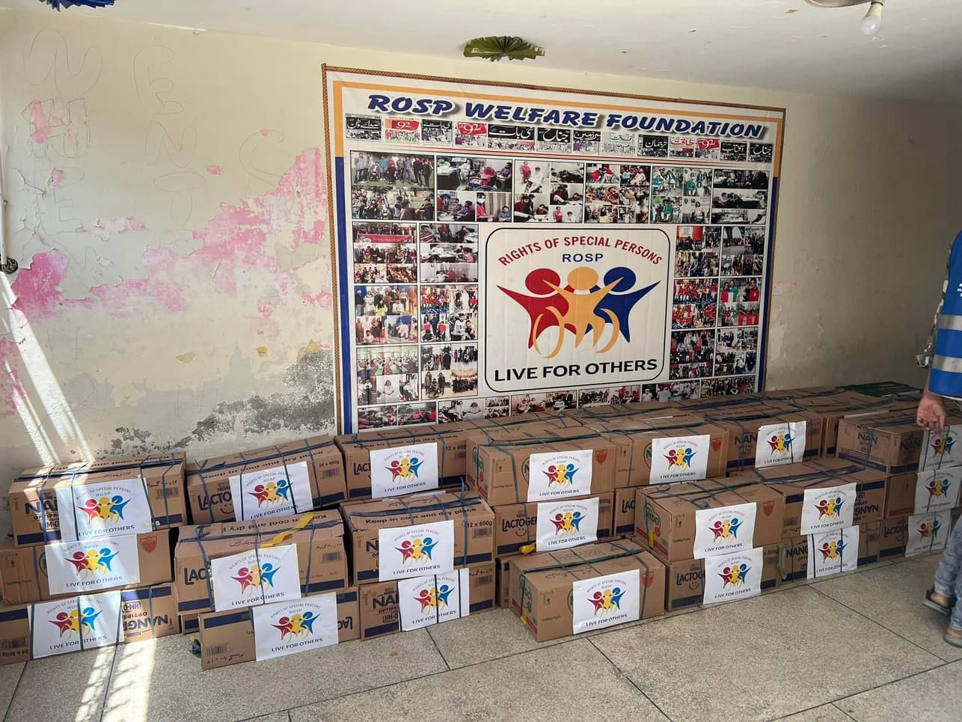
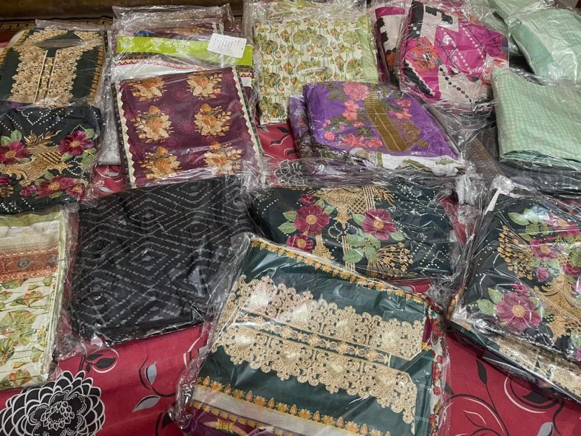
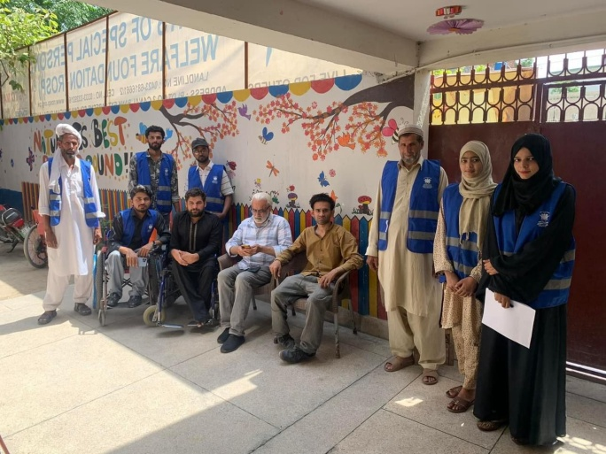
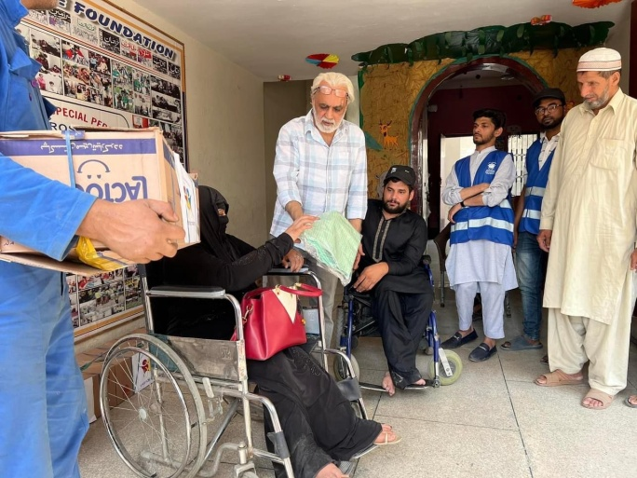
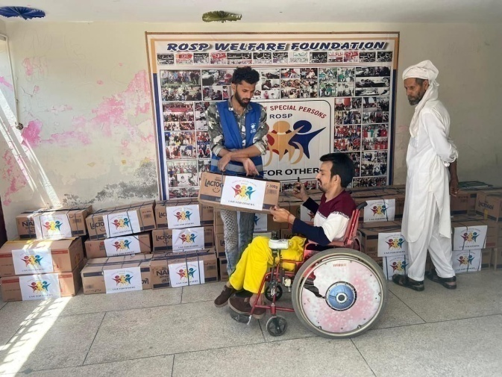
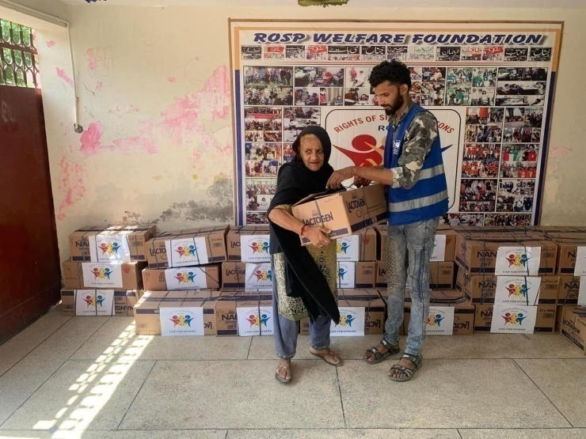
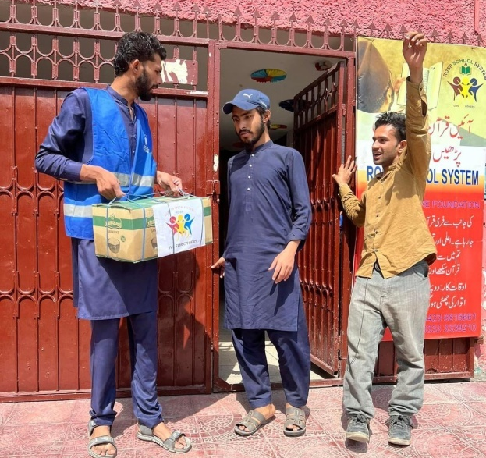
ROSP 8th Ramadan Distribution Ceremoney
Ramadan Food Pack, Wheelchairs & Eid Gift distribution in District Lahore ..ROSP Welfare foundation are working to provide support to those in need, particularly during the holy month of RamadanHundreds of PWDs, Orphan & Widows Families receive food during the holy month every month. We are rooted in financial transparency and strict standards of efficiency. By providing food packages, Wheelchairs & Eid Gift to those affected by any kind of Disability is not only helping to meet immediate nutritional needs but also ensuring that individuals and families have the resources they need to observe their fasts during this important time. This kind of humanitarian assistance can make a significant difference in the lives of those who are struggling.

Slide 14
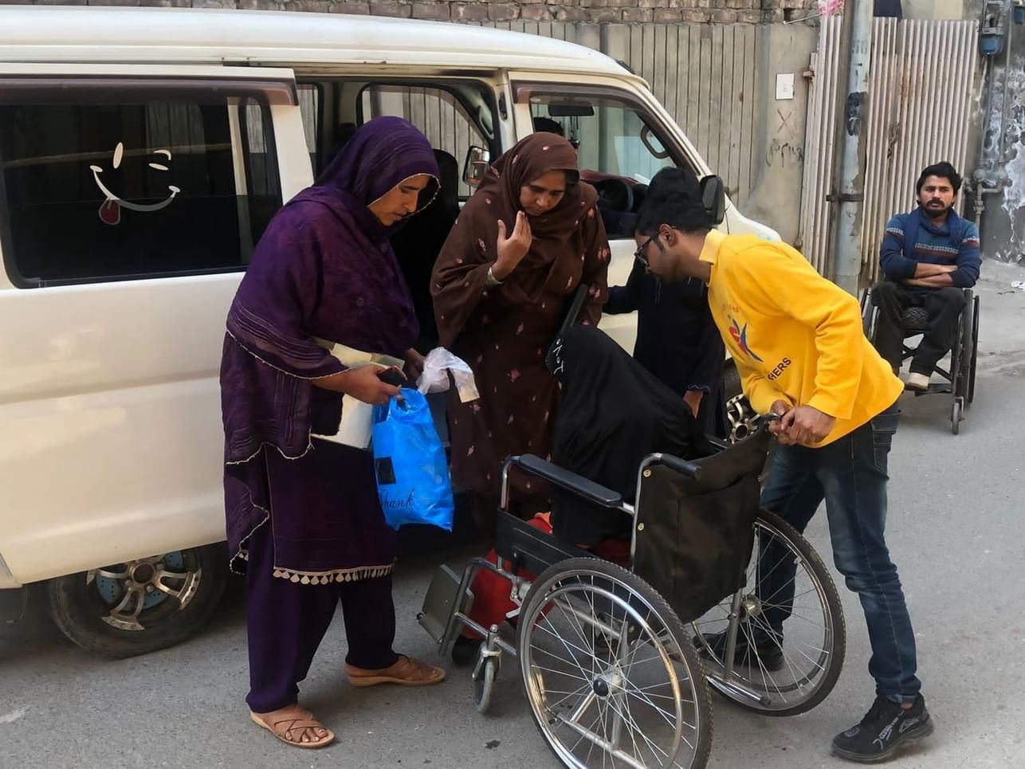
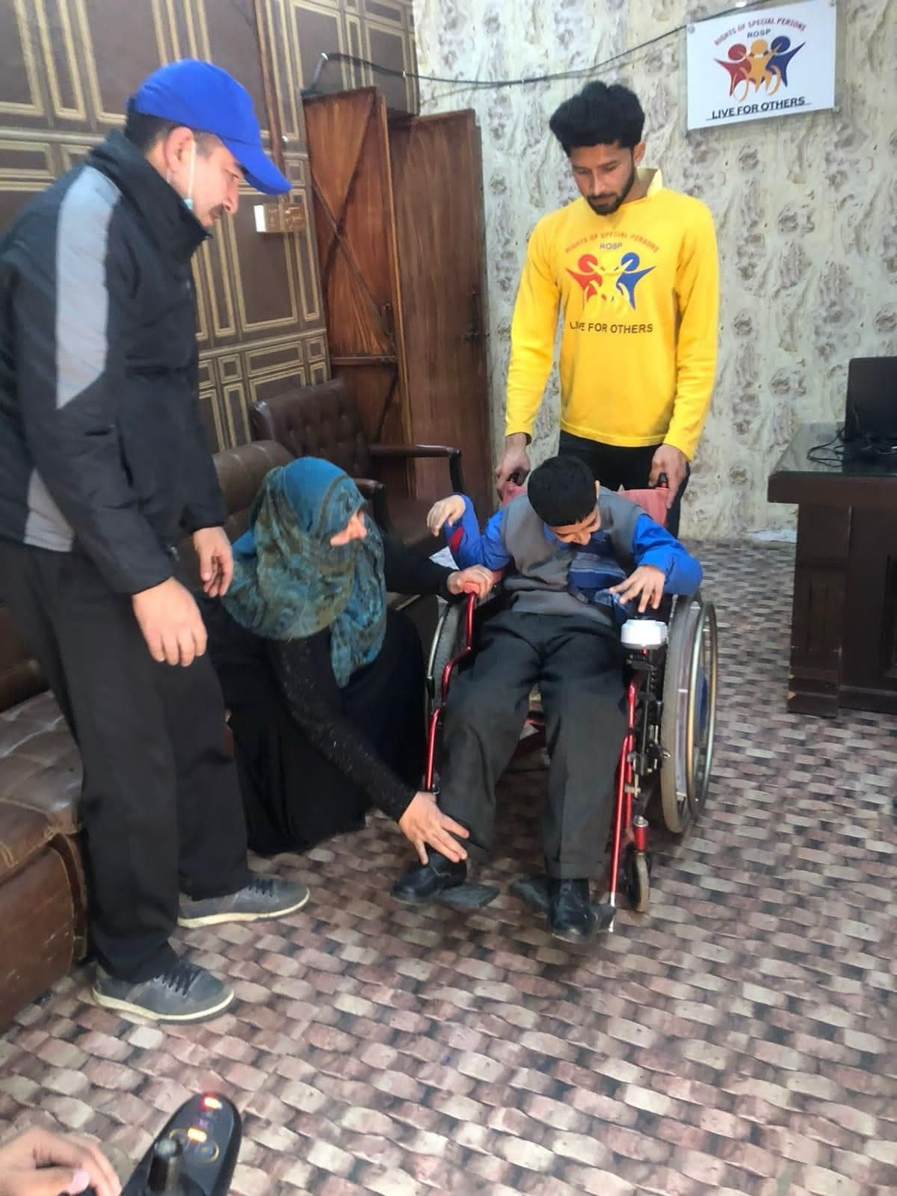
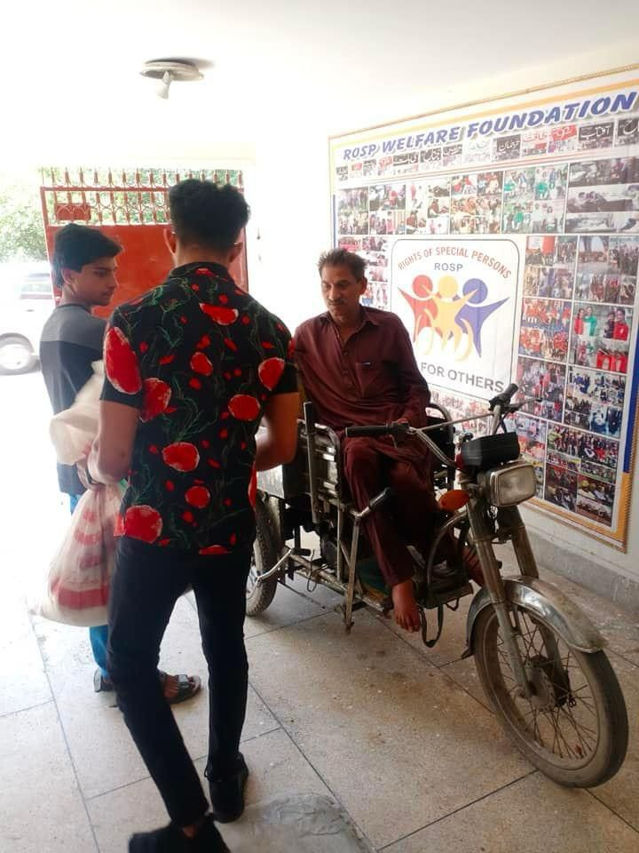
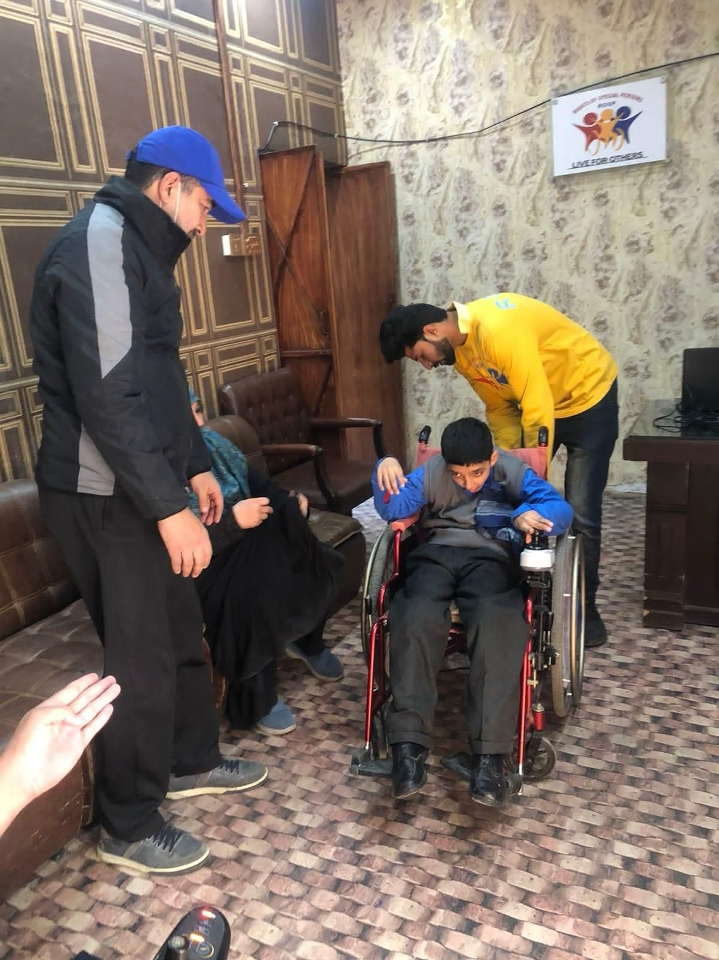
PERSONAL ATTENDANT SERVICES
ROSP is also providing attendant service to severely disabled people at their homes. Attendant helps them with their daily works like eating, toileting, shifting, and cloth changing on a daily basis.
In three years, ROSP has provided these services to 20 families. The demand for this service is increasing day by day as parents are not able to manage their disabled children. Many volunteers are getting registered for outdoor services like going to hospital, shopping and family functions. ROSP is providing training services on attendant services for persons with disability in different university and colleges.

Slide 15
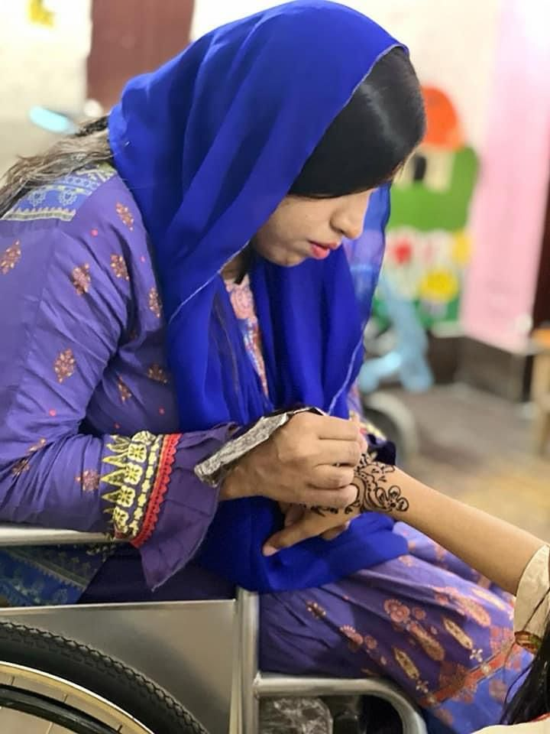
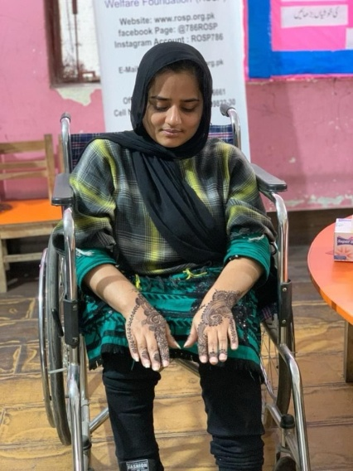
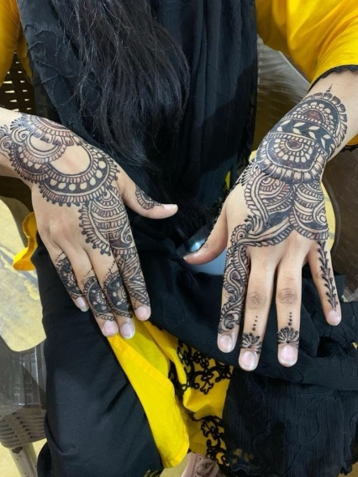
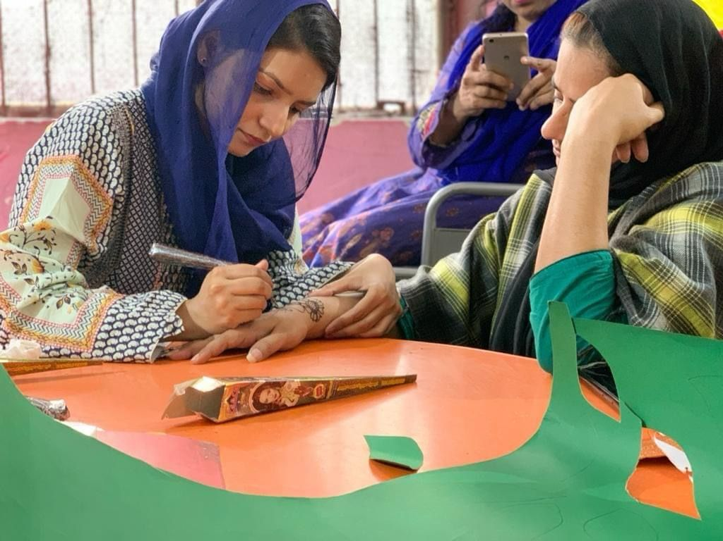




ROSP Welfare Foundation Organised
Mehndi stall was set up for the people of the Area & PWDs.
Eid Mubarak to all Muslims

Slide 16




AWARENESS SESSION
Our team & Staff participated first group Meeting with CPDI Pakistan, Youth Development Foundation & Sudhaar At Avari Xpress Hotel..
Topics :-
Citizens for Good Governance: Strengthening Citizen's engagement for inclusive and Accountable Local Governance Youth Council Session on Identifying issues and Engagement with the Local Governance.

Slide 17




AWARENESS SESSION
Our Team participated at flatties Hotel To address legislative gaps, implementation gaps, and the behavioural change needs to eradicate Child Marriage in Punjab, the Peace & Justice Network (PJN) under the Aawaz II Program is organizing Punjab provincial consultation by inviting all the relevant stakeholders to develop a sustainable strategy.

Slide 18




Employment Program
ROSP’s Employment Program offers assistance and support to individuals with disabilities seeking employment. Employment Consultants provide skills assessment, computer testing, resume preparation, job development, networking opportunities, interviewing skills, on the job training, and career development

Slide 19







MEDICAL PROJECT
We Organised a Medical Session in the ROSP School System A Project of ROSP Welfare foundation for PWD's.

Slide 20

MOU CEREMONEY
First of all I really want to thank the Enablers Enablers by Saqib Azhar eCommerce by Saqib Azhar and specially thanks to Saqib Azhar and your team really amazing team . Aap nay humari community ko independent honay ki big opportunity di Inshallah ye skills inki life ka turning point hoga...

Slide 21







HAPPY INDEPENDENCE CELEBRATION CEREMONY
Held On August 14th, 2023At ROSP Welfare Foundation Lahore.Today it's our 76th Independence Day and we should feel proud to be a part of an Independent nation that has freedom of speech, and freedom to live life in our own way"This Programme Started With The Recitation of the Holy Quran by ROSP School Child’ Then Naat-e-Rasool Maqbool Was Presented.ROSP SchoolchildrenPresented Very popular National Songs And Tablus, Which Were Appreciated By All In The Audiance.Teachers And Children Who Presented Items At The Stage.President Of ROSP School And Foundation ( Mr Wajid Hussain ) Thanked To All Who Came To This Programme Happy Independence Day to My respected teachers and dear friends.

Slide 22



BREAST CANCER AWARENESS
An Interactive Dialogue With The Honourable First Lady Begum Samina Alvi on Breast Cancer, Mental Health & Persons With Disabilities (PWDs) 6th September 2023. At University Of Lahore

Slide 23






Conducted Awareness Session at ROSP Office with RAMP, CIP & Voice Society Promoting the civic & political rights of PWDs & increasing their participation in the electoral Process.

Slide 24






ROSP PRESIDENT MEETING WITH DIFFERENT ORGANIZATION
ROSP Welfare foundation meeting with different PVT-LTD Company & CSR Team's & Different Welfare Organisations Pakistan Centre Philanthrophy, Saaya Association, STEP Organisation, Discretelogix PVT Limited , RDF Pakistan Best Way Cement, Askari Bank, SME & Pakistan Foreign Office Women's Association Ministry of foreign Islamabad and Discussed about future projects..

Slide 25



INTERNATIONAL DISABLED DAY
On the occasion of the International Day of Persons with Disabilities, a protest was held in front of the press club organized by the Rights of Special Persons Welfare Foundation (ROSP). Which was led by Central President Wajid Hussain and well-known Dr. Khalid Jameel, while a large number of disabled people also participated in the protest. On this occasion, Wajid Hussain, the central president of Rights of Special Persons Welfare Foundation (ROSP), while addressing the media representatives, said that special persons also have immense potential to serve the country and the nation. Therefore, the quota in government jobs should be increased from three percent to five percent and special people should be represented in the national and provincial assemblies as well. So that special people can also fight for their rights. On this occasion, Dr. Khalid Jameel said that the Rights of Special Persons Welfare Foundation is fighting for the rights of special persons. They not only instill motivation and hope in special persons but also educate and train them to develop their skills. The entire nation should support those who are supporting their families instead of becoming a burden due to disability.

Slide 26




AWARENESS SESSION
ROSP Team and members Participated Inclusive Livelihood opportunities for all at Nishat Hotel.. Organised By Special Talent Exchange Program (STEP) UNDP

Slide 27




JASHN-E- EID MILAD-UN-NABI (P.B.U.H)
Our multitalented students performed Recite Quran-E- Paak & Different Naat Shareef ..Organized By ROSP SCHOOL SYSTEM A PROJECT BY ROSP WELFARE FOUNDATION 27th September 2023

Slide 28


World Teachers' Day
ROSP Welfare foundation Celebrated World Teachers' Day is held annually on October 5 to celebrate all teachers around the globe. World Teachers' Day is an annual international day which is celebrated on October 5 to celebrate the work of teachers.

Slide 29






ROSP SCHOOL SYSTEM Organised 1st ANNUAL FUNFAIR
Held On October 28th, 2023At Mughalpura Branch Lahore"This Programme Started With The Recitation of the Holy Quran by ROSP School Child’ Then Naat-e-Rasool Maqbool Was Presented.ROSP School childrenPresented Very popular National Songs And Cultural, Balochi K. P. K Punjabiand SindhiTablus, Which Were Appreciated By All In The Audiance, Programme Was attended by chief Guests, Wajid Hussain Who alsopresented Giftd, to school children,Teachers And Children Who Presented Items At The Stage.Funfair is one of the most popular school events. It brings the community together in a spirit of fun. Its a good resource for children to socialize with other children or people. They also get a chance to meet the parents and family members of their friends.There were many games and food stalls which served mouth watering delicacies.Our colorful , fun fair style booths create a festival atmosphere that really attracts a crowd.

Slide 30




ANNUAL MEGA EVENT
ROSP School System Participated Organised by The Trust School Annual Mega Event'23 At Children Library Complex..

Slide 31



CONSULTATIVE MEETING
Recognizing rehabilitation as an indispensable health service, Ministry of NHSRC, in collaboration with Provincial Health and Social Welfare Department, WHO, ReLAB-HS and Humanity Inclusion is organizing 2 Days Consultative Workshop Formulation of Federal & Provincial Rehabilitation & Assitive Technology Strategic Action Plans. (2023-2028)

Slide 32



FUND RAISING EVENT
Today The PSRD Fundraiser Event at Flatti's Hotel Our Mother Institute. Always Old Is Gold.

Slide 33



Ghaza Million March
ROSP's TEAM & Members at Ghaza Million March We Stand with Palestine & We Love Palestine.

Slide 34



OUT OF SCHOOL PROGRAM
ROSP Team, Staff and Student Participated Community Meeting to Engage OOS (Out-of-School) Youth for Good Governance Citizens for Good Governance:Strengthening Citizen’s Engagement for Inclusive and Accountable Local Governance.

Slide 35


MOU SIGNED CEREMONEY
President & Founder Wajid Hussain Rights Of Special Persons Welfare Foundation (ROSP) and CEO of My Impact Meter, Kanwal Cheema have signed an MoU to promote the use of technology for creating social impact, Helping the Deserving Students & Eradicate Poverty In Pakistan.

Slide 36




16th December Black Day
16th December, is considered as a black day because on 16th December,2014. A most cruel terrorist attack took place in Army Public School (APS), Peshawar. In this attack many innocent students lost their precious life, and many got injured. It was the most cruel attack. In the memory of those students and teachers who lost their life in (APS) terrorist attack, ROSP School System A Project Of ROSP Welfare Foundation arranged a prayer meeting on 16th December, 2023. All the students and teachers prayed for the (APS) students that may their souls rest in peace and may God Bless their families to stand strong.

Slide 37



WORKSHOP ON TRAINING MODULE DEVELOPMENT FOR THE PRIVATE SECTOR
ROSP's Team & Members Participated Inclusive livelihood opportunities for all Organised By Special Talent Exchange Program (STEP) UNDP RussiaProgram Rundown 1Empowering Diversity: Workshop on Training Module Development for the private sector on the strategic advancement of inclusion of marginalized communities in the workplace.Objective: The transformative change of this activity will be to build the capacity of the private sector to enable their workplaces and business models to include and empower marginalized communities. Program Rundown 2Empowering Diversity: Mid-Term Review of Pakistan National action plan on Business and Human rights. Lahore - December 29, 2023 (Best Western Premier Hotel)The purpose of this activity is to support MoHR in the mid-term review of the NAP with a particular focus on identifying progress made and remaining gaps in the implementation of NAP targets directly relevant to anti- discrimination, equal opportunity, and inclusion of marginalized groups and women into business activities.

Slide 38








MEDIA COVERAGE

Slide 39
OBJECTIVES
To raise the morale and confidence of persons with disabilities
To sensitize the community on the whole about persons with disabilities and promote their equality.
To creat employment opportunities by lobbying the private and public sectors to make PWDs financially independent.
To reaserch and keep statistics on the issues of the persons with disabilities.
To establish an independent Living Center for persons with disability to provide rehabilitation , specialized and technical education , and vocational training to ake them contributing and honorable citizens.
To assist PWDs in bringing their hidden potential to the surface by providing career guaidence.
To help parents of PWDs by educating them on various aspects of all the disability of their child.
To creat opportunity for social and cultural activities for mainstreaming of PWDs talent.
To encourage sports and games of the PWDs
To creat a culture of volunteerism to cultivate support for the people with disabilitis.
To provide medical facilities.

Slide 40
SPONSORSHIP PLAN
I would like to sponsor a Person with disabilities (PWDs) Orphan & deserving families: (Please tick the relevant box)
EDUCATION
Mobility
Boarding House
Skill Education
Rashan Program
Scholarship | Monthly Amount | Annually Scholarship
Per Student | 10,000 PKR | 120,000 PKR
Per Wheelchair | Special Bike | Auto Rickshaw | Cruches/ Walker
25,000 PKR | 150,000 PKR | 250,000 PKR | 5,000 PKR
Per Day | Per Month | Annually Amount
500 PKR | 15,000 PKR | 180,000 PKR
Scholarship | Monthly Amount | Annually Amount
Per Student | 4,000 PKR | 48,000 PKR
Per Month Family Pack | Per Year Total Amount
8,000 PKR | 96,000 PKR

Slide 41
HOW TO DONATE
Bank Name: Bank Al Habib Account Title: Rights Of Special Persons Welfare Foundation Branch Name: Jail Road Lahore A/c No: 55280081000192012
Bank Name: Meezan Bank Account Title: Rights Of Special Persons Welfare Foundation Branch Name: Shah Jamal IBAN #: PK28 MEZN 0011 3501 0321 0205 A/c No: 1135 0103210205
Bank Name: Mobilink Bank
Account Title: Rights Of Special Persons Welfare Foundation
Branch Name:Ferozpure Road Shama Stop
Account No. 136737333
Bank Name: Silk Bank
Account Title: Rights Of Special Persons Welfare Foundation
Branch Name: MM Alam Road
Account No. PK70SAUD0050615000543917

